Slide 1
HTML
Dr Govindha Ramaiah Yeluripati

Slide 2
Introduction to HTML
HTML stands for Hyper Text Markup Language
It uses markup to define the structure of web pages

Slide 3
Introduction to HTML
HTML consists of a series of elements
HTML elements tell the browser how to display the content

Slide 4
HTML Elements
HTML elements are defined by tags.
Format of a tag: a start tag, some content, and an end tag
<tagname> Content goes here... </tagname>
Example:
<h1>My First Heading</h1>
<p>My first paragraph.</p>
Empty elements: HTML elements that have no content
E.g., the <br> element meant for line break.
Empty elements do not have an end tag!

Slide 5
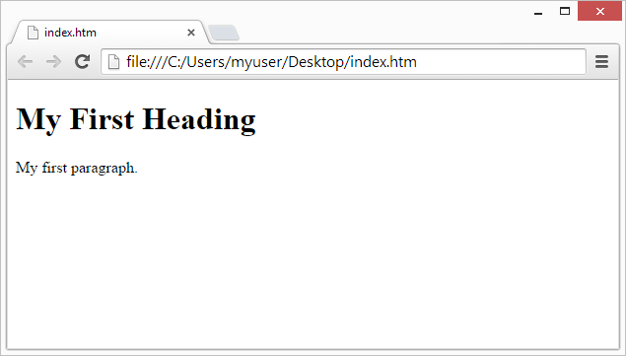
Web Browsers
The purpose of a web browser (e.g., Chrome, Edge, Firefox, Safari) is to read HTML documents and display them correctly.
A browser does not display the HTML tags but uses them to determine how to display the document.

Slide 6
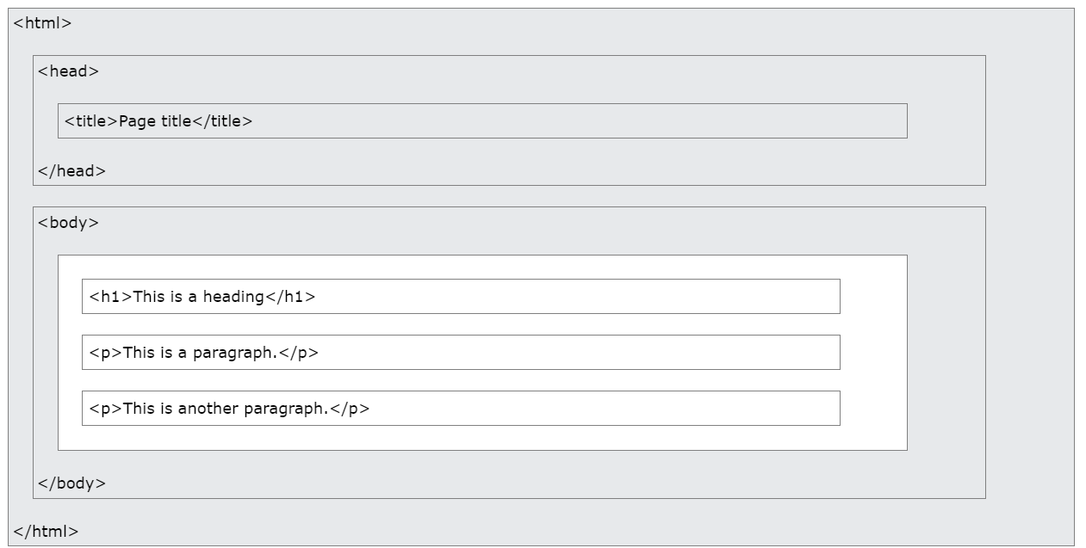
HTML Page Structure
<html> is the root element
<head> specifies the meta-information about the document
shown in the browser's title bar or in the page's tab
<body> contains the visible page content that will be displayed in a browser

Slide 7
A simple HTML Document
defines this document as an HTML5 document.
All HTML documents must start with this.
<!DOCTYPE html>
<html>
<head>
<title>Page Title</title>
</head>
<body>
<h1>My First Heading</h1>
<p>My first paragraph.</p>
</body>
</html>
root element of an HTML page
contains meta-information about the HTML page
specifies a title for the HTML page
defines the document's body, and is a container for all the visible contents, such as headings, paragraphs, images, hyperlinks, tables, lists, etc.

Slide 8
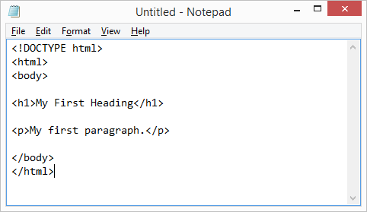
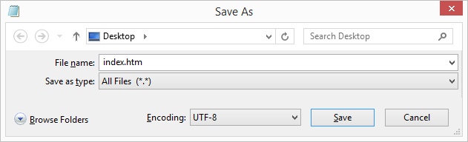
HTML Editors
A simple text editor (e.g., Notepad or Notepad++) is all you need to create HTML documents.
You can use either .htm or .html as the file extension while saving.
Set the encoding to UTF-8 (which is the preferred encoding for HTML files)

Slide 9
The <!DOCTYPE> Declaration
Represents the document type and helps browsers display web pages correctly.
Must appear only once, at the top of the page (before any HTML tags).
It is not case-sensitive.
The <!DOCTYPE> declaration for HTML5 is:
<!DOCTYPE html>

Slide 10
HTML Headings
HTML headings are defined with the tags:
<h1>, <h2>, <h3>, <h4>, <h5>, and <h6>.
<h1> defines the most important heading.
<h6> defines the least important heading.
Example:
<h1>This is heading 1</h1>
<h2>This is heading 2</h2>
<h3>This is heading 3</h3>

Slide 11
HTML Paragraphs
HTML paragraphs are defined with the <p> tag.
A paragraph always starts on a new line, and browsers automatically add some white space (a margin) before and after a paragraph.
Example:
<p>This is a paragraph.</p>
<p>This is another paragraph.</p>

Slide 12
HTML Links
HTML links are defined with the <a> tag (or anchor tag).
Example:
<a href="https://www.ashesi.edu.gh">This is ashesi's link</a>
The link's destination is specified in the href attribute.
Attributes are used to provide additional information about HTML elements.

Slide 13
HTML Images
HTML images are defined with the <img> tag. (or image tag)
The source file (src), alternative text (alt), width, and height are provided as attributes.
Does not require a closing tag because it is a self-contained, void element.
Example:
<img src="C:\Users\ygovi\OneDrive\Pictures\Saved Pictures\Ashesi_Logo.jpg" alt="Ashesi Logo" width="104" height="104">

Slide 14
HTML Videos
To show a video in HTML, use the <video> element.
Example:
<video width="320" height="240" controls>
<source src="C:\Users\ygovi\Videos\mov_bbb.mp4"
type="video/mp4">
<source src="movie.ogg" type="video/ogg">
Your browser does not support the video tag.
</video>

Slide 15
HTML Videos: Note on the Example
The controls attribute adds video controls, like play, pause, and volume.
To start a video automatically, use the autoplay attribute:
It is a good idea to always include width and height attributes. If height and width are not set, the page might flicker while the video loads.
The <source> element allows you to specify alternative video files which the browser may choose from. The browser will use the first recognized format.
The text between the <video> and </video> tags will only be displayed in browsers that do not support the <video> element.

Slide 16
HTML Videos: Note on the Example
Chromium browsers do not allow autoplay in most cases.
However, muted autoplay is always allowed.
Example:
<video width="320" height="240" autoplay muted>
<source src="C:\Users\ygovi\Videos\mov_bbb.mp4"
type="video/mp4">
<source src="movie.ogg" type="video/ogg">
Your browser does not support the video tag.
</video>

Slide 17
HTML Comments
Comments in HTML are written between <!-- and -->.
Anything inside this tag will be ignored by the browser.
Example:
<!-- <p> This paragraph is temporarily disabled and will not appear on the page. </p> -->

Slide 18
Nested HTML Elements
HTML elements can be nested (this means that elements can contain other elements).
All HTML documents consist of nested HTML elements.
Example: contains <html>, <body>, <h1> and <p>
<!DOCTYPE html>
<html>
<body>
<h1>My First Heading</h1>
<p>My first paragraph.</p>
</body>
</html>

Slide 19
HTML is Not Case Sensitive
HTML tags are not case sensitive: <P> means the same as <p>.
The HTML standard does not require lowercase tags but is a recommended practice.
NOTE:
Some HTML elements will display correctly, even if you forget the end tag. However, never rely on this! Unexpected results and errors may occur if you forget the end tag!

Slide 20
HTML Attributes
All HTML elements can have attributes
Attributes provide additional information about elements
Attributes are always specified in the start tag
Attributes usually come in name/value pairs like; name="value"

Slide 21
Some HTML Attributes
The title attribute defines some extra information about an element. The value of the title attribute will be displayed as a tooltip when you mouse over the element.
Example:
<p title="I'm a tooltip">This is a paragraph.</p>
The href Attribute specifies the URL of the page the link goes to.
The src attribute specifies the path to the image to be displayed as used in the <img> tag

Slide 22
Absolute Vs Relative URLs
There are two ways to specify the URL in the src attribute:
1. Absolute URL - Links to an external image that is hosted on another website.
Example: src="https://www.ashesi.edu.gh/images/img_logo.jpg".
Note: External images might be under copyright. If you do not get permission to use it, you may violate copyright laws. In addition, you cannot control external images; they can suddenly be removed or changed.
2. Relative URL - Links to an image that is hosted within the website. Here, the URL does not include the domain name. If the URL begins without a slash, it will be relative to the current page.
Example: src="/images/img_logo.jpg".

Slide 23
Some HTML Attributes
The <img> tag should also contain the width and height attributes, which specify the width and height of the image in pixels.
The required alt attribute for the <img> tag specifies an alternate text for an image if the image for some reason cannot be displayed. This can be due to a slow connection, an error in the src attribute, or if the user uses a screen reader.
The style attribute in HTML is used to apply inline CSS (Cascading Style Sheets) to an element. It allows you to define specific CSS properties directly within an HTML tag, controlling the appearance of that element.
Example: <p style="color:red;">This is a red paragraph.</p>
<p style="color: blue; font-size: 16px;">This is a blue paragraph.</p>

Slide 24
Some HTML Attributes
You should always include the lang attribute inside the <html> tag, to declare the language of the Web page. This is meant to assist search engines and browsers.
Examples:
<!DOCTYPE html>
<html lang="en">
<body>
...
</body>
</html>
---------------------------------------
<!DOCTYPE html>
<html lang="en-US">
<body>
...
</body>
</html>
Quotes for attribute values are optional but it is recommended to use either single or double quotes to avoid any possible errors.

Slide 25
Bigger Headings
Each HTML heading has a default size.
However, we can specify the size for any heading with the style attribute, using the CSS font-size property.
Example:
<h1 style="font-size:60px;">Heading 1</h1>

Slide 26
HTML Display
You cannot be sure how HTML will be displayed.
Large or small screens and resized windows will create different results.
With HTML, you cannot change the display by adding extra spaces or extra lines in your HTML code. The browser will automatically remove any extra spaces and lines when the page is displayed.
Example:
<p>
This paragraph
contains a lot of spaces
in the source code,
but the browser
ignores it.
</p>

Slide 27
More Styles: Background Color
The CSS background-color property defines the background color for an HTML element.
Example;
<h1 style="background-color:powderblue;">This is a heading</h1>
<p style="background-color:tomato;">This is a paragraph.</p>

Slide 28
More Styles: Fonts
The CSS font-family property defines the font to be used for an HTML element.
Example:
<h1 style="font-family:verdana;">This is a heading</h1>
<p style="font-family:courier;">This is a paragraph.</p>
The CSS font-size property defines the text size for an HTML element.
Example:
<h1 style="font-size:300%;">This is a heading</h1>
<p style="font-size:160%;">This is a paragraph.</p>

Slide 29
More Styles: Text Alignment
The CSS text-align property defines the horizontal text alignment for an HTML element.
Example:
<h1 style="text-align:center;">Centered Heading</h1>
<p style="text-align:right;">Right aligned paragraph.</p>

Slide 30
HTML Formatting Elements
Formatting elements were designed to display special types of text.
<b> - Bold text
<strong> - Important text
<i> - Italic text
<em> - Emphasized text
<mark> - Marked text
<small> - Smaller text
<del> - Deleted text
<ins> - Inserted text
<sub> - Subscript text
<sup> - Superscript text

Slide 31
HTML Quotation and Citation Elements
Used for quotations and citations to semantically distinguish quoted or cited text from the rest of the content.
These elements help improve readability, accessibility, and proper structuring of web content.
<blockquote> →for long block-level quotations
<q> →for short inline quotations.
<cite> →for citing the title of a work (not the author or person quoted).
<abbr> →Defines an abbreviation or an acronym
<address> → Defines contact information
<bdo> →Overrides the current text direction

Slide 32
Quotation and Citation: <blockquote> element
Defines a section that is quoted from another source.
Browsers usually indent <blockquote> elements.
The optional cite attribute is used to specify the source of the quote, although it is not displayed to the user by default.
Example:
<p>Here is a quote from the Ashesi Website:</p>
<blockquote cite="https://www.ashesi.edu.gh">
Our campus, which blends modern architecture with traditional Ghanaian design, offers a beautiful and inspiring setting.
</blockquote>

Slide 33
Quotation and Citation: <q> element
Defines a short inline quotation.
Browsers normally insert quotation marks around the quotation.
Example:
<p> WWF's goal is to: <q> Build a future where people live in harmony with nature.</q> </p>

Slide 34
Quotation and Citation: <cite> element
Defines the title of a creative work (e.g., a book, a poem, a song, a movie, a painting, a sculpture, etc.).
Note: A person's name is not the title of a work.
The text in the <cite> element is usually rendered in italics.
Example:
<p> <cite> The Scream </cite> by Edvard Munch. Painted in 1893.</p>

Slide 35
Quotation and Citation: <abbr> element
Defines an abbreviation or an acronym, like "HTML", "CSS", "Mr.", "Dr.", "ASAP", "ATM" etc.
Marking abbreviations can give useful information to browsers, translation systems and search engines.
It's a good practice to use the global title attribute to show the description for the abbreviation/acronym when you hover the mouse over the element.
Example:
<p>The <abbr title="World Health Organization"> WHO</abbr> was founded in 1948.</p>

Slide 36
Quotation and Citation: <address> element
Defines the contact information for the author/owner of a document or an article.
The contact information can be an email address, URL, physical address, phone number, social media handle, etc.
The text in the <address> element usually renders in italics, and browsers will always add a line break before and after the <address> element.
Example:
<address>
Dr Govindha Yeluripati.<br>
Website:www.ashesi.edu.gh<br>
1, University Avenue, Berekuso<br>
ER, Ghana </address>

Slide 37
Quotation and Citation: <bdo> element
BDO stands for Bi-Directional Override.
The HTML <bdo> tag is used to override the current text direction.
Example:
<bdo dir="rtl">This text will be written from right to left</bdo>

Slide 38
HTML Colors
HTML colors are specified with predefined color names, or with RGB, HEX, HSL, RGBA, or HSLA values.
Please check: https://www.w3schools.com/html/html_colors.asp

Slide 39

HTML Favicon
A favicon is a small image displayed next to the page title in the browser tab.
Any image (simple, high contrast) can be used as a favicon. A common name for a favicon image is "favicon.ico"
One can also create their favicon on sites like https://www.favicon.cc.
To create, add a <link> element to the "index.html" file, after the <title> element

Slide 40
HTML Favicon: Example
<!DOCTYPE html>
<html>
<head>
<title>Favicon Demo</title>
<link rel="icon" type="image/x- icon" href="/images/favicon.ico">
</head>
<body>
<h1>This is a Heading</h1>
<p>This is a paragraph.</p>
</body>
</html>

Slide 41
Tables
Meant for arranging data into rows and columns.
A table in HTML consists of table cells inside rows and columns.
Each table cell is defined by a <td> and a </td> tag, where td stands for table data.
Everything between <td> and </td> is the content of the table cell.
A table cell can contain all sorts of HTML elements: text, images, lists, links, other tables, etc.

Slide 42
Table: Example
tr stands for table row
<table>
<tr>
<th>Company</th>
<th>Contact</th>
<th>Country</th>
</tr>
<tr>
<td>Alfreds Futterkiste</td>
<td>Maria Anders</td>
<td>Germany</td>
</tr>
<tr>
<td>Centro comercial Moctezuma</td>
<td>Francisco Chang</td>
<td>Mexico</td>
</tr>
</table>
th stands for table header
By default, the text in <th> elements is bold and centred but can be changed with CSS.
Row 1 (Header)
Row 2
Row 3

Slide 43
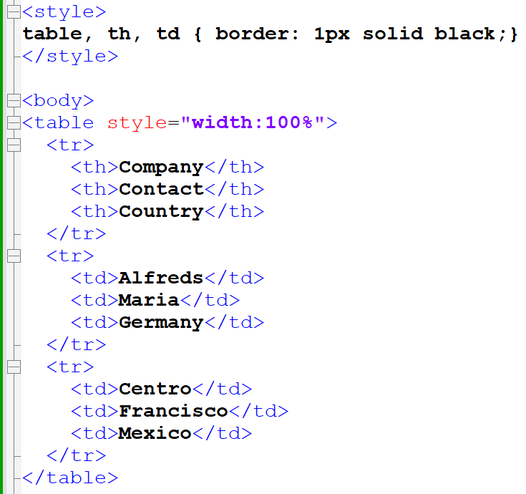
Table: style and border

Slide 44
Table
Check more about table formatting at:
https://www.w3schools.com/html/html_tables.asp

Slide 45
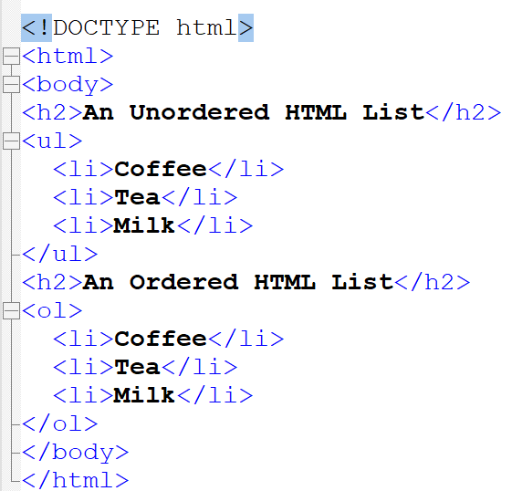
HTML Lists
Allow to group a set of related items.
Example:
Un-ordered List
Ordered List

Slide 46
HTML Forms
An HTML form is used to collect user input.
The user input is most often sent to a server for processing.
The <form> element is used to create an HTML form.
<form>
...
form elements
...
</form>
The <form> element is a container for different types of input elements, such as text fields, checkboxes, radio buttons, submit buttons, etc.

Slide 47
HTML Forms: <input> Element
Most used form element.
An <input> element can be displayed in many ways, depending on the type attribute.
Type | Description
<input type="text"> | Displays a single-line text input field
<input type="radio"> | Displays a radio button (for selecting one of many choices)
<input type="checkbox"> | Displays a checkbox (for selecting zero or more of many choices)
<input type="submit"> | Displays a submit button (for submitting the form)
<input type="button"> | Displays a clickable button
Check https://www.w3schools.com/html/html_form_input_types.asp for more types

Slide 48
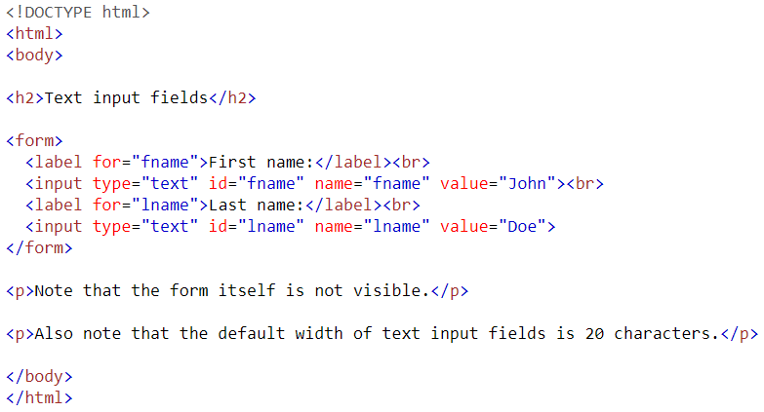
HTML Forms: Text Fields
<input type="text"> defines a single-line input field for text input.

Slide 49
The <label> Element
The <label> tag defines a label for many form elements.
The <label> element is useful for screen-reader users because the screen-reader will read out loud the label when the user focuses on the input element.
The <label> element also helps users who have difficulty clicking on very small regions (such as radio buttons or checkboxes) - because when the user clicks the text within the <label> element, it toggles the radio button/checkbox.
The for attribute of the <label> tag should be equal to the id attribute of the <input> element to bind them together.

Slide 50
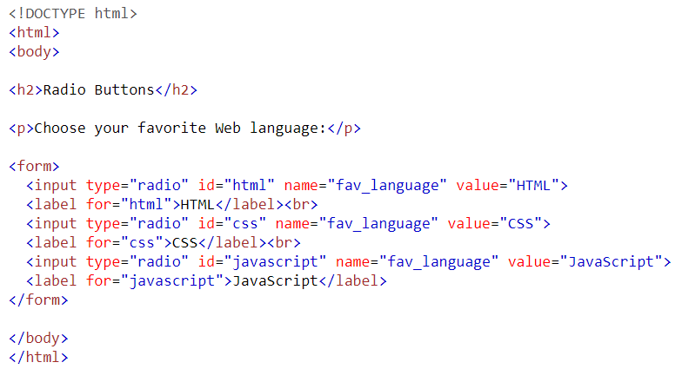
HTML Forms: Radio Buttons

Slide 51
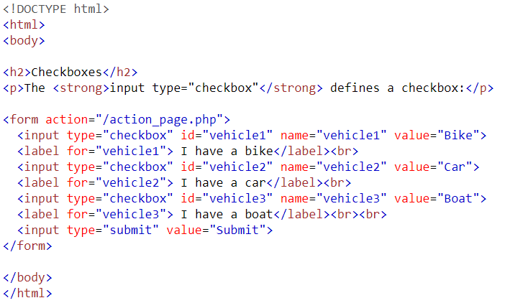
HTML Forms: Check Boxes

Slide 52
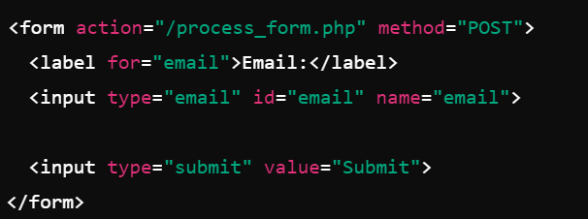
HTML Forms: Submit Button
The <input type="submit"> defines a button for submitting the form data to a form handler.
The form handler is typically a file on the server with a script for processing input data.
The form handler is specified in the form's action attribute.

Slide 53
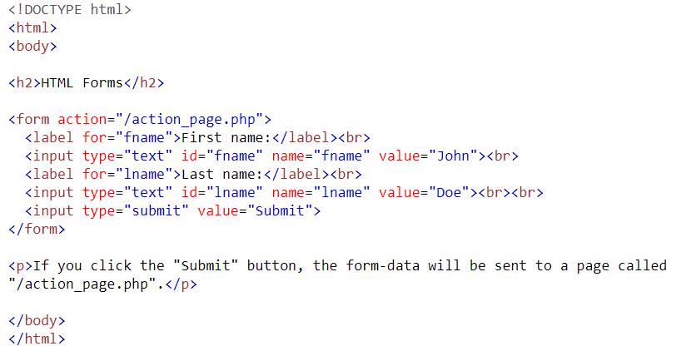
HTML Forms: Text Fields with Submit
Text fields example:

Slide 54
HTML Input: A note on name attribute
Each input field must have a name attribute to be submitted.
If the name attribute is omitted, the value of the input field will not be sent at all.

Slide 55
HTML Metadata
Metadata is data that describes other data.
In HTML, metadata provides information about the webpage, including its title, author, description, and how search engines or social platforms should display it.
It doesn't directly appear on the webpage but is important for SEO, accessibility, and browser behaviour.

Slide 56
HTML Metadata
Commonly used metadata elements included in <head>.
<title>Page Title</title>
<meta charset="UTF-8">
<meta name="viewport" content="width=device-width, initial-scale=1.0">
<meta name="description" content="A brief description of the webpage for SEO purposes.">
<meta name="keywords" content="HTML, CSS, JavaScript">
<meta name="author" content="Your Name">
<link rel="icon" href="/path/to/favicon.ico" type="image/x-icon">
<link rel="stylesheet" href="styles.css">
<link rel="canonical" href="https://example.com">
<script src="script.js" defer></script>

Slide 57
HTML <div>
The <div> element is used as a container for other HTML elements.
The <div> element is by default a block element, meaning that it takes all available width, and comes with line breaks before and after.
The <div> element is often used to group sections of a web page together.
Example:
<div>
<h2>London</h2>
<p>London is the capital city of England.</p>
<p>London has over 13 million inhabitants.</p>
</div>

Slide 58
Things to explore further
Canvas
APIs: GeoLocation
Media: Audio, Video, Plug-ins
Reference: https://www.w3schools.com/html/default.asp

Slide 59
Thank you
Questions???
Govindha Yeluripati

